Slide 1

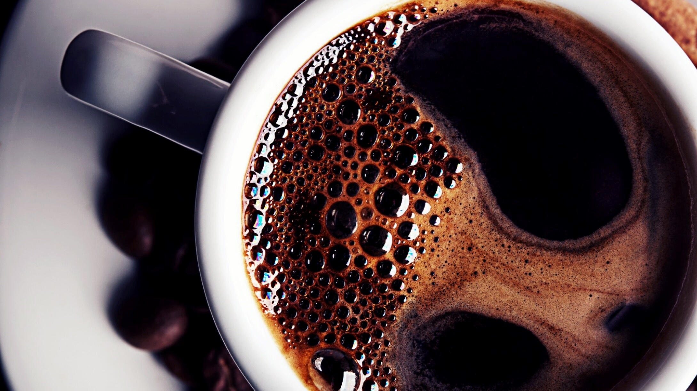
Stock Market Prediction using Twitter Sentiment Analysis
Under the guidance of
Prof. Shaun Hayden
Submitted by,
Varun Changala
10537424@mydbs.ie

Slide 2
INTRODUCTION
In the modern world, we rely on digital information just to survive and progress at the same time.
As we go through the day-to-day motions, it is important to understand the how this changes our existence and what can be done with this enormous amount of information.
A lot of our questions can be answered just based on trends and connections between multiple sentiments.
Our study is focusing on the impact of a social media channel i.e. Twitter on the stock prices of the companies listed on NASDAQ.
We are trying to find out how a group of tweets can change the values of stocks and can help the company in gaining profit or can cause loss.

Slide 3
Research Aim and Objective
To download twitter data using the #Apple or #AAPL.
To download the stock data matching with the same timeline of the twitter data.
To find the sentiment of the tweets using python.
To prove the correlation between the twitter and stock data.
To apply multiple regression and correlation models to find the best model.

Slide 4
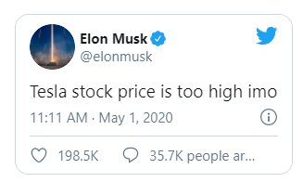
Dataset : Twitter
Why Twitter ?
Twitter is a rich source of real-time information regarding current social trends and opinions.
Twitter Data: Data from Kaggle (https://www.kaggle.com/nadun94/twitter-sentiments-aapl-stock)
The consumer of today is not as rational as before and their decisions can be changed easily, due to this the stock prices can drastically go up or down just because of a tweet.
The dataset contains 922 rows and 9 columns.

Slide 5
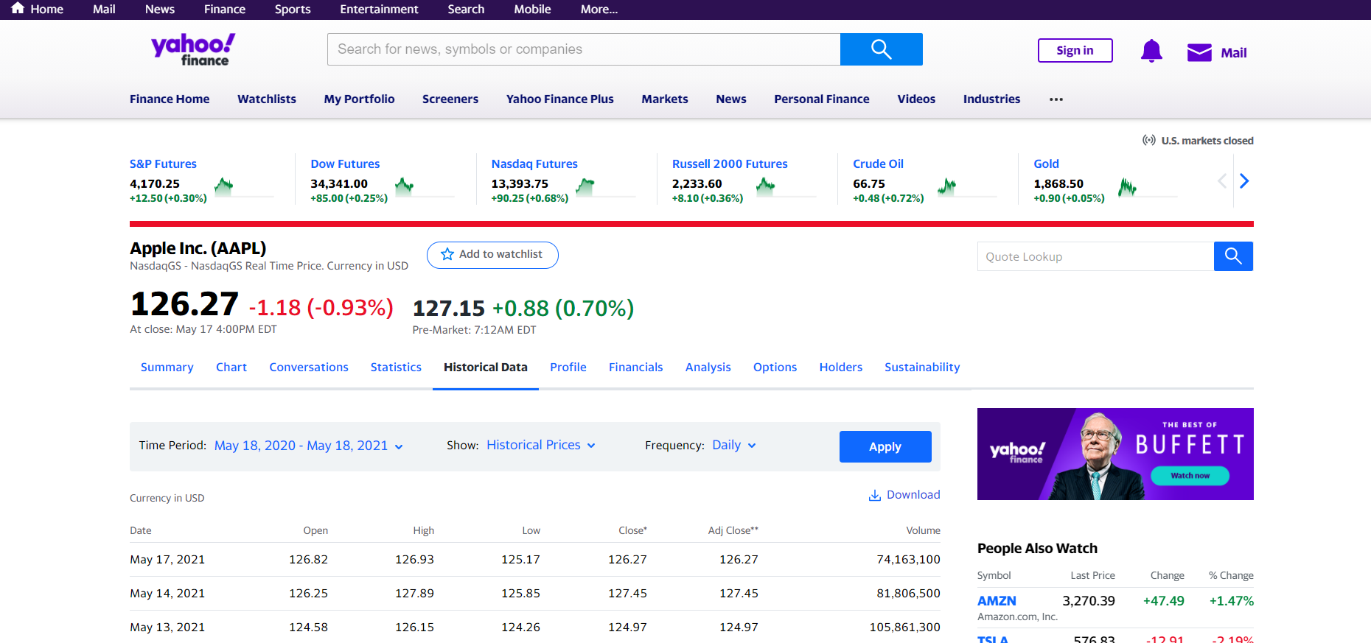
Dataset : Apple Inc.
Why stocks of Apple Inc?
Apple Inc. is the first trillion dollar company with many users/haters around the world.
As they release new models ever year with a different operating system competing with many other companies.
Stock Data: Stock Price of Apple from Yahoo Finance from Jan 01, 2016 to Aug 31, 2019.
We considered the stock data of the company while they took the drastic decision of removing the headphone jock from their new iPhone.
The dataset contains data from which the stock market was open for making upto 265 days.

Slide 6
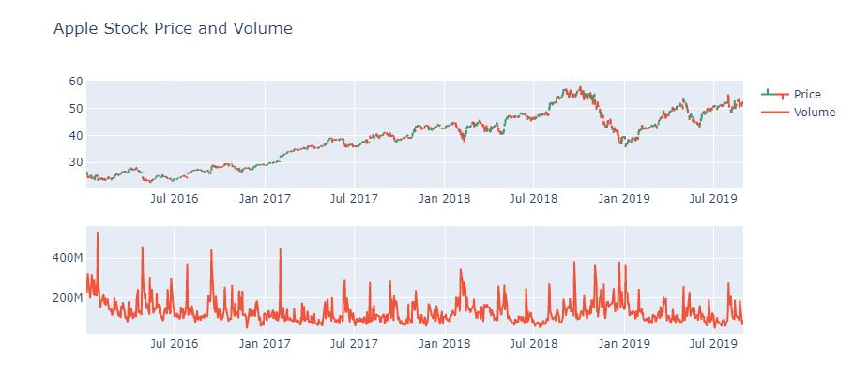

Slide 7
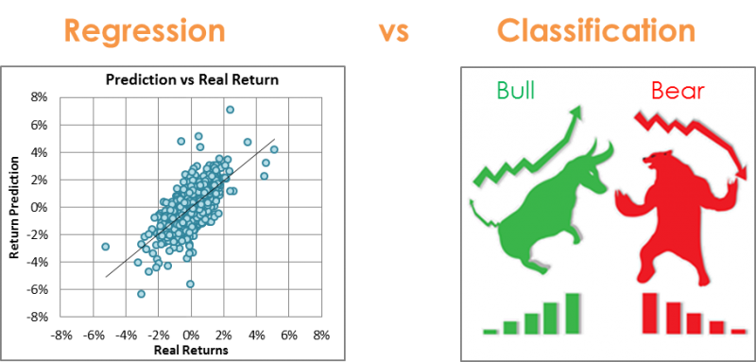
METHODOLOGY
REGRESSION Models used:
LSTM RNN
Random Forest Regressor
XG Boost Regressor
CLASSIFICATION Models used:
Random Forest Classifier
Gradient Booster

Slide 8
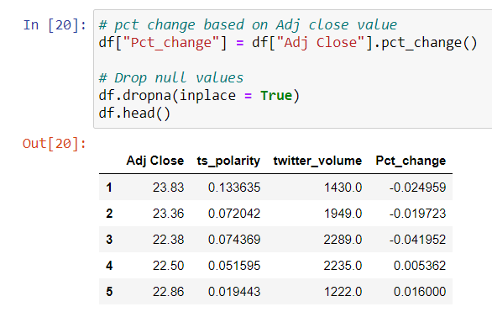
Regression
From the main dataset we created a new dataframe which contains only the adjusted closing price of the stock, polarity of the tweets, twitter volume.
Then we also calculated the pct change of the adjacent closing price column and added it as a new column to the dataframe using pct_change() function.
Pct_change() function calculates the percentage between the current and the prior element. This function by default calculates the percentage change from the immediately previous row.

Slide 9
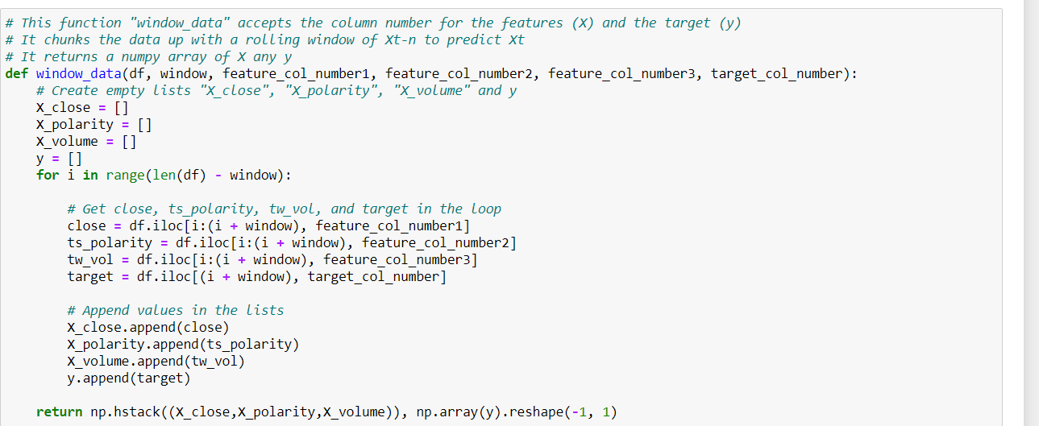
Regression
A rolling windows-based regression method was used on adjusted closing prices for Apple stock.
The 3 previous days prices were used as features and the 4th day price was used as target vector.
Twitter polarity scores and volume were also used as features.

Slide 10
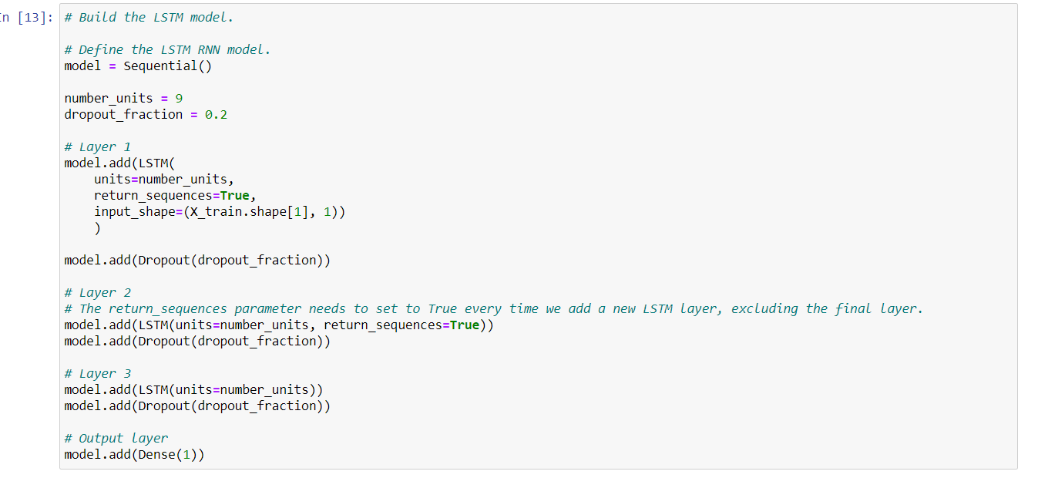
LSTM RNN model
To create a LSTM model we added LSTM layers. The return sequences parameter need to be true everytime we add a new layer, excluding the final layer. The input_shape is the number of time steps and the number of indicators.
After each LSTM layer, we add a dropout layer to prevent overfitting. The parameter passed to the dropout layer is the fraction of nodes that will be drop on each epoch, for this demo, we will use a dropout value of 0.2, it means that on each epoch we will randomly drop 20% of the units.
The number of units in each LSTM layers, is equal to three times the size of the time window, we are taking three previous closing prices to predict the next closing price.

Slide 11
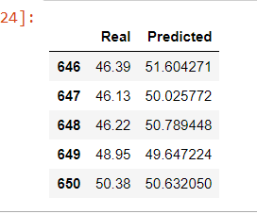
LSTM RNN Result
After training the model and making predictions we acquired such results.
Root mean squared error: 0.13338730
R-squared: 0.68007098
We also created a dataframe with the real and predicted values.

Slide 12
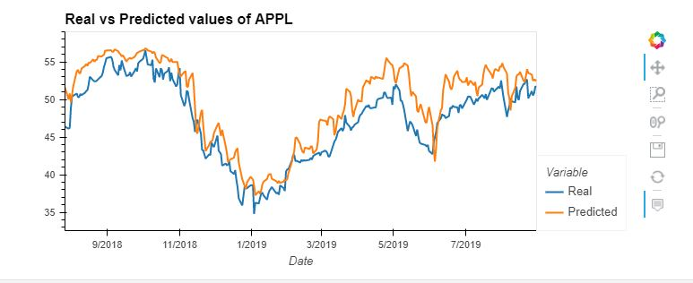

Slide 13
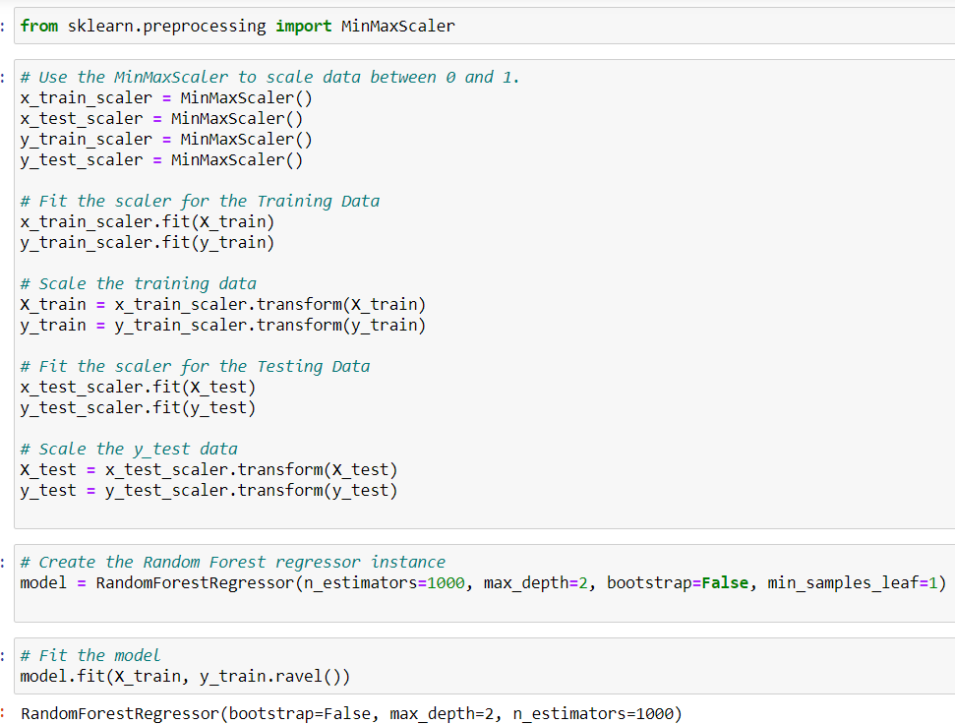
Random Forest Regressor model
We used MinMaxScaler from sklearn to scale all values between 0 and 1. we scale both features and target.
We created the RF Regressor instance by giving n_estimators=1000, max_depth=2, bootstrap=False, min_samples_leaf=1.

Slide 14
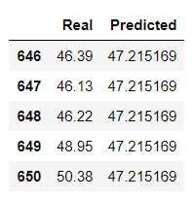
Random Forest Regressor Result
After training the model and making predictions we acquired such results
Root mean squared error: 0.099290351
R-squared: 0.82272858
We also created a dataframe with real and predicted values

Slide 15
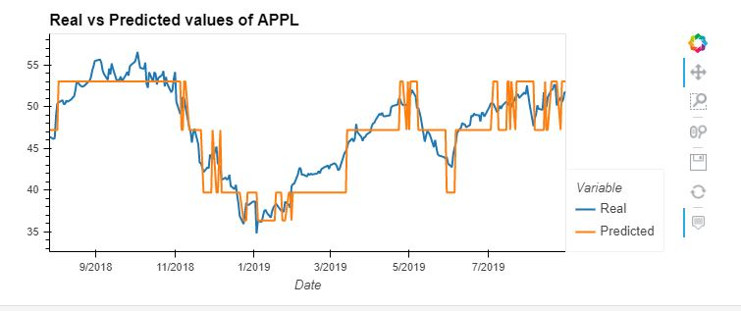

Slide 16
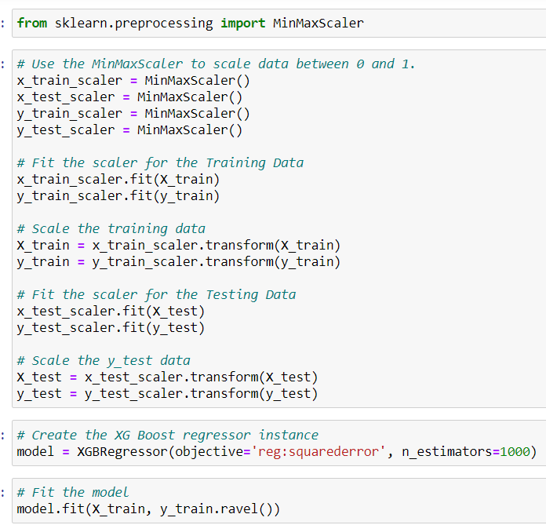
XG Boost model
We used MinMaxScaler from sklearn to scale all values between 0 and 1. we scale both features and target.
We created the XGBoost regressor instance by giving the objective as squarederror and n_estimators= 1000.

Slide 17
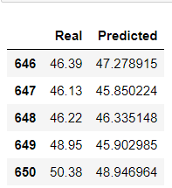
XG Boost model Result
After training the model and making predictions we acquired such results
Root mean squared error: 0.047662971
R squared: 0.95915049
We also created a dataframe with real and predicted values

Slide 18
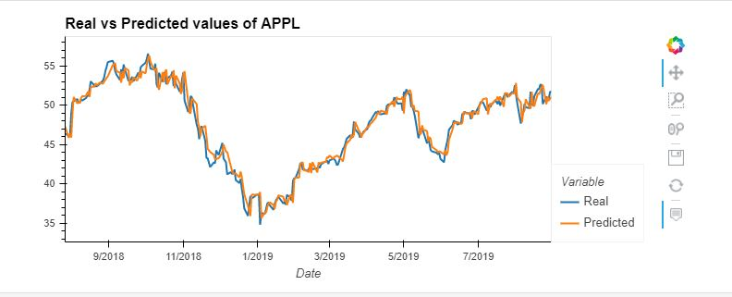

Slide 19
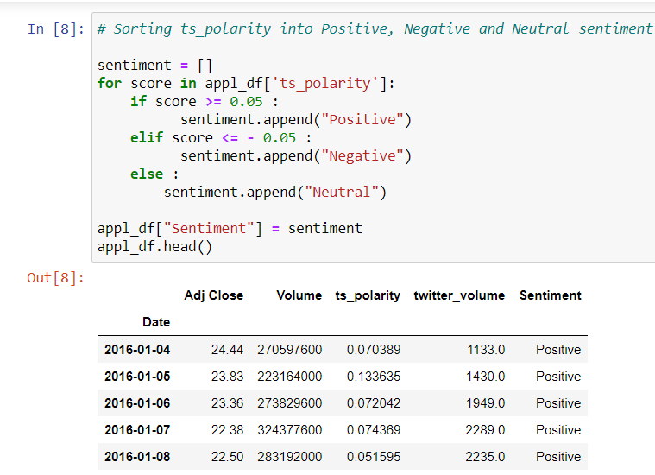
Classification
The adjusted closing price for Apple stock was converted into binary form based on the difference in current price vs previous day price.
This was done to analyze the trend in the market with a rise represented as 1 and a fall in price is represented as 0.
Twitter polarity scores were used to clarify tweets into positive, negative and neutral sentiments. Binary encoding of these sentiments was used to run the classifier models.

Slide 20
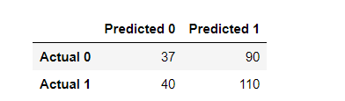
Random Forest Classifier Result
We created the Random forest model using n_estimators= 500, random_state= 78.
After fitting the model and making predictions we acquired an accuracy score of 0.53068592
We also generated a confusion matrix for the actual and predicted values.

Slide 21
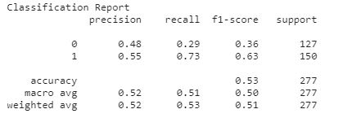

Slide 22
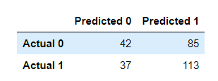
Gradient Booster Result
We trained the model with different learning rates i.e., 0.05, 0.1, 0.25, 0.5, 0.75, 1 and found out that the model gives best result at 0.75.
We created the model using n_estimators= 20, learning_rate= 0.75, max_features= 5, max_depth= 3, random_state= 0.
After fitting the model and making predictions we acquired an accuracy of 0.55956678
We also generated a confusion matrix with the actual and predicted values

Slide 23
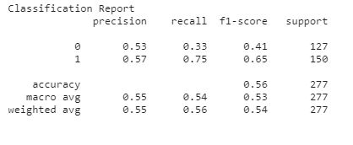

Slide 24
Conclusion
This project shows that there is evidence of dependence between stock price and twitter sentiment.
The regression approach turned out to be a better approach for predicting apple stock as opposed to the classification approach.
However, this needs to be further investigated to accurately forecast a connection between social media and market behaviour.

Slide 25
Future Scope
Tweepy library.
News API headlines with multiple social media platforms.
Large stock data.

Slide 26
THANK YOU
VARUN CHANGALA
10537424@mydbs.ie

